Slide 1

Windows CE System
4. Windows CE System Architecture
School of software Engineering
2005

Slide 2
Overview
System Architecture
NK.EXE
FILESYS.EXE
DEVICE.EXE
GWES.EXE
SERVICES.EXE
Thread Migration

Slide 3
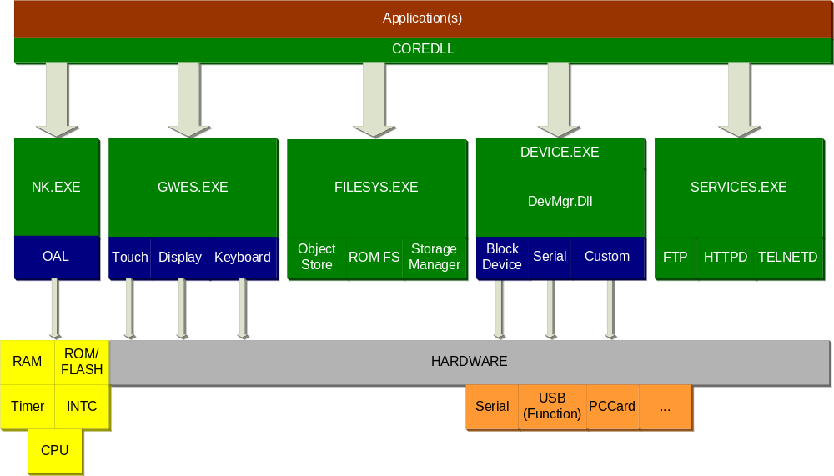
Windows CE System Architecture

Slide 4
NK.EXE
NK.LIB + OAL.LIB = NK.EXE
  Kernel is Hardware architecture agnostic but CPU Instruction set specific
  Designed to keep OAL as small as possible
Microsoft Provides NK.LIB as a pre-built library
  Most of the Source is available via Shared Source License
  More available via Premium Shared Source Program
Provides
  Memory Management
  Scheduler
  Protected Server Library (PSL) Call mechanism for Micro-Kernel Architecture
  Base Win32 Function implementation
NK
.
EXE
OAL
RAM
ROM
/
FLASH
Timer
INTC
CPU

Slide 5
Protected Server Libraries (PSL)
System Process that implements a system API Set
Mechanism for implementing OS functionality in isolated processes
PSL Calls run through the Kernel (NK.EXE)
  Not end user extensible
    You can’t just create a new PSL and plug it in

Slide 6
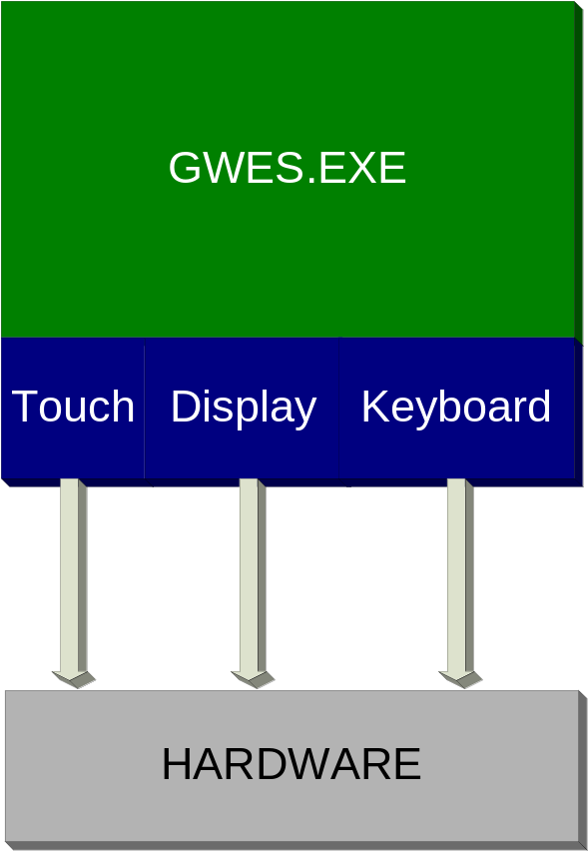
GWES.EXE
Graphical Windowing and Events System (GWES)
  NLED driver removed in V5.0 so GWES now builds separate from BSP
Manages all Graphical User Interface and input devices
Desktop USER32 + GDI32 as a single PSL Process

Slide 7
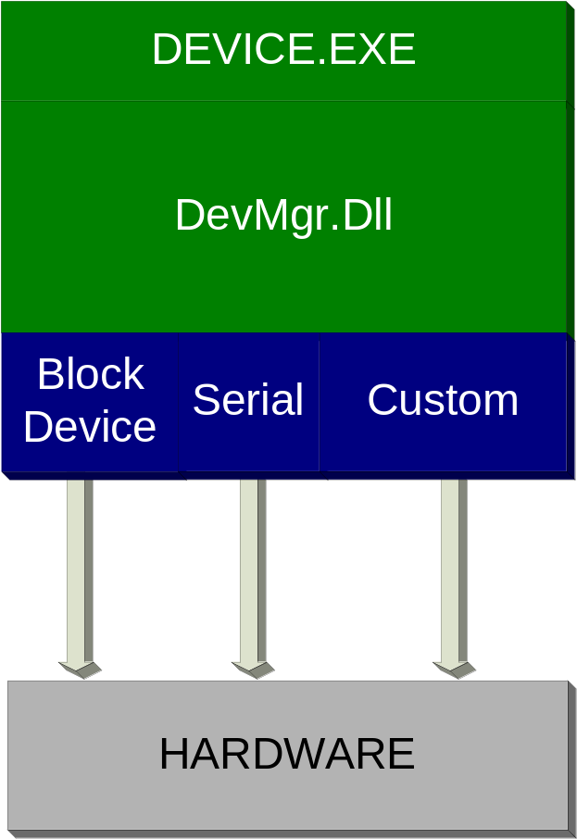
DEVICE.EXE
Device Manager
  Battery driver removed from GWES in V4.1 it is now a stream driver in device.exe
    Works on headless devices!
  Separated core as a DLL for use by drivers to make faster calls to device manager APIs
Provides all Driver related APIs to System
Uses registry to load Bus Drivers at boot time

Slide 8
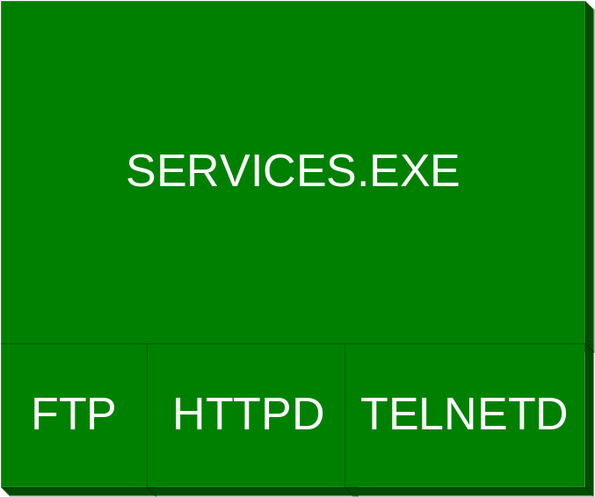
Services.EXE
Host process for Services
  Separated from Device.exe for greater isolation
FTP, TELNET, HTTPD (Web), UPnP, SMB, etc…
Custom Services
Command line utility for starting, stopping and restarting services
Programmatic APIs for manipulating services

Slide 9
File System
All file system functions and APIs are managed by FileSys.exe
Has a single root “\”, but has NO driver name like “C:”
Has 3 components:
  Object Store
  Storage Manager
  ROM File System

Slide 10
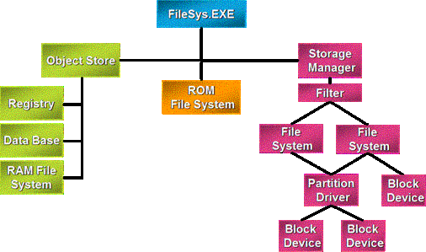
File System Overview

Slide 11
Object Store
A heap managed by FileSys.exe
Including:
  Registry
  Database
  RAM File System
RAM File System usually use the root directly
  Ex : “\myfile.txt” is in RAM

Slide 12
ROM File System
Mapped as “\Windows” directory
All Files in “\Windows” are read only
Usually is the image of nk.nb0

Slide 13
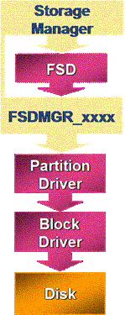
Storage Manager
Responsible for:
  Storage device driver
  Partition device driver
  File System device driver
  File System filter

Slide 14
Thread Migration
CreateFile(…)

Slide 15
Overview
Processes
Threads
Virtual Memory

Slide 16
Windows CE Kernel Features
Multiple processes
  Can support maximum of 32 separate processes
Multiple threads
  Supports 256 thread priorities
Fibers
  Unit of execution that must be manually scheduled by the application
Synchronization objects
  Critical Sections, Mutexes, Semaphores, Events, Message Queues
Memory model
  Virtual memory, Code sections Paged, No backing store for Data sections

Slide 17
Processes
Static context within which one or more threads run
  Processes aren’t scheduled to run – threads are.
The maximum number of simultaneous processes is limited 32 processes because:
  It is a reasonable limit for most embedded devices, as using multi-thread is recommended over multi-processes
  Architecture of some supported CPUs have fixed MMU mappings.
Windows CE uses the same loading and unloading mechanism as Windows XP
  (and other desktop Win32 versions of Windows)
Support for console applications
  But not the same API as desktop Win32
Call CreateProcess() to start a process

Slide 18
Threads
Unit of execution in Win32
Scheduled by the OS based on Priority
Higher priority threads pre-empt lower priority threads when ready to run
Threads at the same priority are scheduled in a Round-Robin fashion.
Default Quantum is 100ms configurable by OEM in OAL
  Can also be programmed per thread at run time.

Slide 19
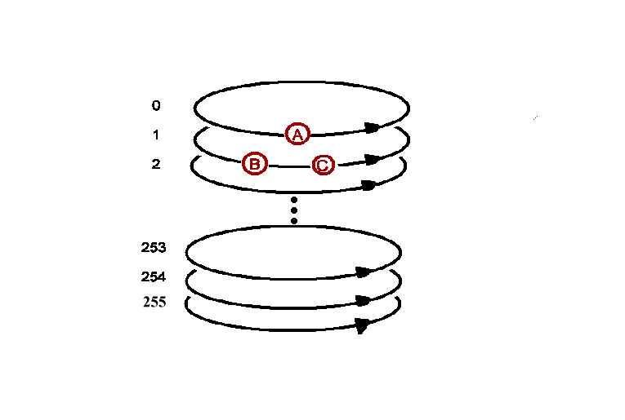
Thread Priority
Thread A is in the highest priority and runs until blocked or completion
Thread B and C run in “round-robin” as long as thread A is blocked
In round-robin each thread runs for a specific amount of time – called a quantum
The lower the priority number the higher the priority

Slide 20
Thread Priority Map (Example)
Priority | Component
0-19 | Open – Real Time Above Drivers
20 | Graphics Vertical Retrace
99 | Power management Resume Thread
100-108 | USB OHCI UHCI, Serial
109-129 | IRSIR1, NDIS, Touch
130 | KITL
131 | VMini
132 | CxPort
145 | PS2 Keyboard
148 | IRComm
150 | TAPI
248 | Power Management
249 | WaveDev, Mouse, PnP, Power
250 | WaveAPI
251 | Normal
252-255 | Open - Applications

Slide 21
Priority Inversion
Avoid priority inversion by keeping all threads waiting for same resource at the same priority
Example: Thread 1 blocked waiting for resource owned by Thread 3, causing Priority Inversion
Priority
Inversion
Priority
Restored
High Priority
Thread 1
Thread 3
Thread 1
Blocked
Preempt
Medium Priority
Thread 2
Thread 2
Blocked
Preempt
Blocked
Low Priority
Thread 3
Thread 3
Resource Owner:
Thread 3
Thread 1
Notes:
There are two primary architectural choices for an OS to handle Priority inversion in a system: Single Level and Fully Nested. In the Fully Nested Mode the OS will walk through all threads blocked and keep boosting each one until the high priority thread can run. This prevents an entire class of deadlocks. Unfortunately it also means an O(n) operation with pre-emption turned off while the scheduler figures out how to get everything unblocked to keep things going. This is a major problem for real-time systems that need deterministic response times.
In order to support hard real-time systems Windows CE V3.0 and later switched to using a Single Level handling of priority inversion. That is the OS will boost only one thread to release a block. It is therefore the responsibility of the developer to structure code such that deadlocks are avoided.

Slide 22
Thread API
Thread Creation
  CreateThread – Creates a new thread at normal priority
Thread Priority
  GetThreadPriority – current priority level of a thread
  SetThreadPriority – change priority level of a thread from normal (251)
  CeGetThreadPriority – current priority level of a real-time thread
  CeSetThreadPriority – change priority level of a real-time thread
Thread Suspend
  Sleep(0) – relinquish remainder of quantum to other threads in its priority
  Sleep (n) – milliseconds to suspend execution
  Sleep (INFINITE) – suspend execution until thread termination or resume
  SleepTillTick – suspend execution until next system tick
  SuspendThread – increments suspend count to stop user-mode
  ResumeThread – decrements suspend count

Slide 23
Process & Thread
Windows CE process does NOT support Environment variable
  _wfopen (L“%WINDOWS%\\a.txt”, L“w”); // error
Windows CE process does NOT support Current directory
  _wfopen(L“a.txt”, L“w”); // error, first search root directory, then search \Windows directory.

Slide 24
Synchronization Objects
Thread
  Requests a synchronization object and blocks while object is not in “Signaled” state
  Resumes when the object it is in “Signaled” state
Synchronization Object Types
  Critical Section
  Mutex
  Semaphore
  Event
Also can use Interlocked functions & point-to-point message queue
Notes:
NOTE: The signaled and non signaled states are a concept that also applies to Thread handles returned from CreateThread() and process handles returned from CreateProcess(). The handles are signaled while the thread or process is still active. Both handles are still valid after the thread or process exits and will be in the signaled state at that point.

Slide 25
Synchronization (Critical Sections)
Overview
  Allows multiple threads shared access to same data
  Protects a section of code with mutual-exclusive access
  Other threads blocked until ownership is released
  Each CS is an application provided data structure that is used by OS
  Only useful within a single process but more efficient than a MUTEX
Functions
  InitializeCriticalSection
        Allocates CRITICAL_SECTION structure for a CriticalSection object
  EnterCriticalSection
        Calls blocked until owner thread calls LeaveCriticalSection
  TryEnterCriticalSection
        Non-blocking version of EnterCriticalSection
  LeaveCriticalSection
        Releases ownership of a CriticalSection object
  DeleteCriticalSection
        Releases resources allocated by InitializeCriticalSection
Notes:
Critical sections are data structures allocated by the application (often statically allocated) that are initialized before use. This means the OS does not actually own the “object instance” and it cannot be shared across processes. Critical Sections are extremely efficient when the code normally does not need to block. In this case there is no transition to the kernel so there is little actual overhead involved. If it does need to block a critical section actually resolves to the equivalent of a Mutex so is not as efficient if a lot of blocking is expected. Profiling code with the Kernel Tracker will help to reveal how your code behaves under real conditions.
Many embedded Operating Systems have the notion of a critical section that is an equivalent to turning all interrupts off. Windows CE critical sections do not have this functionality. As described above they are a special kind of mutex. Turning interrupts off is not supported outside of the OAL in Windows CE.

Slide 26
Synchronization Objects (Mutexes)
Overview
  Only one thread can own a mutex at a time
  Global named mutex objects permits inter-process synchronization
  Signaled state when not owned by a thread
  Non-signaled state when it is owned by a thread
Functions
  CreateMutex
        Creates named or unnamed mutex object if it doesn’t already exist
        Non-blocking with return status for already exists or abandoned
  WaitForSingleObject or WaitForMultipleObject
        Calls blocked until current owner releases specified mutex object
        Calls non-blocking while waiting for a mutex object it already owns
  ReleaseMutex
        Called once per call returned from Wait function
        Abandoned state if not called before owner thread terminates
  CloseHandle
        Releases and Destroys mutex object upon last handle close
Notes:
Mutexes are, as the name implies, Mutual Exclusion objects that are similar to Critical sections. The principal differences is that Mutexes are true OS Kernel Objects with a handle and can be named for use across processes. It is therefore important to Close the handle to a Mutex when it is no longer needed to prevent leaking a kernel resource
Mutexes are, as the name implies, Mutual Exclusion objects that are similar to Critical sections. The principal differences is that Mutexes are true OS Kernel Objects with a handle and can be named for use across processes. It is therefore important to Close the handle to a Mutex when it is no longer needed to prevent leaking a kernel resource.

Slide 27
Synchronization Objects (Semaphores)
Overview
  Limits the number of threads using a protected resource
  Global named semaphore objects for inter-process synchronization
  Signaled state when its count is greater than zero
  Non-signaled state when its count is zero
Functions
  CreateSemaphore
        Creates named or unnamed semaphore object if it doesn’t already exist
        Multiple processes can use the same named semaphore object
  WaitForSingleObject or WaitForMultipleObject
        Calls blocked until semaphore count is non-zero
  ReleaseSemaphore
        Increments semaphore count by specified amount
  CloseHandle
        Destroys a semaphore object upon closing its last handle
Notes:
The state of a semaphore object is signaled when its count is greater than zero and non-signaled when its count is equal to zero. The lInitialCount parameter of CreateSemaphore() specifies the initial count. Each time a waiting thread is released because of the semaphore's signaled state, the count of the semaphore is decreased by one. Use the ReleaseSemaphore() function to increment a semaphore's count by a specified amount. The count can never be less than zero or greater than the value specified in the lMaximumCount parameter.
Multiple processes can have handles of the same semaphore object, enabling use of the object for inter-process synchronization. To share an object, a process can specify the name of a semaphore object in a call to the CreateSemaphore() function.

Slide 28
Synchronization Objects (Events)
Overview
  Local un-named event objects used within process context
  Global named event objects permits inter-process synchronization
  Signaled state when event occurs
  Non-signaled state when event has not occurred
Functions
  CreateEvent - Creates named or unnamed event object
  SetEvent - Set event object to signaled
  ResetEvent - Set event object to nonsignaled
  PulseEvent - Set event object to signaled and then resets it to nonsignaled after releasing specified number of threads
  WaitForSingleObject or WaitForMultipleObject - Calls blocked until specified event is signaled
  CloseHandle - Destroys an event object upon closing its last handle
Notes:
PulseEvent and SetEvent have different behavior depending on whether it’s a manual reset event or an auto-reset event. In the Auto-reset case only one thread waiting on the event will be released. In the manual reset case all waiting threads are released. Auto-reset events are central to interrupt processing where only one thread can wait on an interrupt event.

Slide 29
Synchronization (Interlocked Functions)
Overview
  Synchronize access to variable shared between multiple threads
  Prevents thread from being pre-empted while accessing shared variable
  Interlocked atomic actions provides mutually exclusive calls between threads
Functions
  InterlockedIncrement - Increment a shared variable and check resulting value
  InterlockedDecrement - Decrement shared variable and check resulting value
  InterlockedExchange - Exchange values of specified variables
  InterlockedTestExchange - Exchange values when a variable matches
  InterlockedCompareExchange - Atomic exchange based on compare
  InterlockedCompareExchangePointer - Exchange values on atomic compare
  InterlockedExchangePointer - Atomic exchange of a pair of values
  InterlockedExchangeAdd - Atomic increment of an Addend variable
Notes:
The interlocked functions allow for atomic read modify write manipulations of data values and pointers. These are useful as they don’t require the overhead of an actual synchronization object.

Slide 30
Synchronization (Point-to-Point Message Queues)
Overview
  Allows multiple readers of user-defined message queue
  High priority and alert messages
Functions
  CreateMsgQueue - Creates or opens a message queue
  OpenMsgQueue - Opens a handle to an existing message queue
  CloseMsgQueue - Closes an open message queue
  ReadMsgQueue - Reads a single message from a message queue
  WriteMsgQueue - Writes a single message into a message queue
  GetMsgQueueInfo - Returns information about a message queue
Notes:
Point to point message queues are separate from window and thread message queues (GetMessage()/PostThreadMessage(), etc…) and different still from Microsoft Message Queuing. Point to Point Queues are implemented in the kernel for maximum efficiency. They are the preferred Inter Process Communication mechanism. Their efficiency comes from the fact that they are implemented completely in the kernel. It’s possible for an application to implement this same functionality on it’s own using the Synchronization objects and shared memory etc… However it’s much more efficient when the entire mechanism is implemented in the kernel as there is no transition into or out of the kernel for each synchronization object access needed to implement the queues. The basic useage scenario is an application creates a message queue and

Slide 31
Memory Management
Application
C Runtime (mallc, new…)
Logical Memory (Heap, stack)
Virtual Memory
Physical Memory
* Storage Device
* Exist only in desktop windows

Slide 32
Memory Architecture
Physical Memory
  Actual RAM/ROM and memory mapped devices with addresses as they appear on the external (or internal) bus
Virtual Memory
  Memory system that runs addresses through a Memory Management Unit (MMU) that translates a “Virtual” address into a physical one.
  Allows for paging code in to memory as needed

Slide 33
Virtual Memory
Virtual memory management
  Windows CE provides only one virtual address space of 4 GB for all the applications to use
  System still maintains protection between processes
  Allows faster inter-process thread migration.
Using virtual memory
  Allocate large blocks of memory
  Windows CE manages virtual memory in 64 KB blocks
Using the local heap
  region of reserved virtual memory space that Kernel manages for your application
Using the stack
  Is the storage area for variables that are referenced in a function
Reserved
2GB
Memory Mapping
(Shared)
Slot 32:Process32
2GB
.
.
.
Slot 1:XIP DLL Code
32MB
Slot 0:Active Process

Slide 34
Overview
Virtual Memory Model
Static Mapped Virtual Addresses
Process Model
Process Memory
Processes
Modules
Heaps
Stack

Slide 35
Virtual Memory Model
Virtual Memory
  Single 32-bit (4 Gigabyte) flat virtual memory address space
  Permits efficient use of physical memory with protection
Virtual Addressing
  Memory Management Unit (MMU) “owns” physical memory
  Virtual addresses translated to physical addresses by MMU
  A valid virtual address must map to a physical address
  Static or Dynamically mapped virtual addressing
Physical Addressing
  Only used by CPU before MMU is activated during power-up

Slide 36
Virtual Memory Model
Privilege Modes
  Virtual memory space split between Kernel-mode and User-mode
  All processes share the same flat virtual memory address space
  Kernel-mode manages User-mode process protection via MMU
Kernel Space
  Used only by Kernel-mode code with privileged access (Kmode)
  Mostly static mapped virtual addresses (never page faults)
User Space
  Organized as 64 slots of 32 MB (2²⁵ bytes) each
  Mostly dynamically mapped virtual addresses

Slide 37
Virtual Memory Model
Kernel Space
Total 4 GB Virtual
Space
User Space
FFFF FFFF
7FFF FFFF
Kernel Addresses: KPAGE, Trap Area, Others
2 GB
Slots 33-63
Object Store and
Memory-Mapped Files
E000 0000
Unused
Kernel Space
C400 0000
Slot 97: NK.EXE
C200 0000
4200 0000
Unused
2 GB
C000 0000
User
Space
Statically Mapped Virtual Addresses: Un-Cached
Slots 2-32 - Processes
A000 0000
Statically Mapped Virtual Addresses: Cached
Slot 1 – XIP DLL code
0400 0000
Slot 0 – Current Process
0200 0000
8000 0000
0000 0000

Slide 38
Static Mapped Virtual Addresses
Physical Memory
Virtual Memory
FFFF FFFF
Kernel Space
C000 0000
512 MB
Uncached
32 MB Flash
64 MB RAM
A000 0000
512 MB
Cached
32 MB Flash
82000000
32 MB Flash
64 MB RAM
04000000
8000 0000
64 MB RAM
2 GB
User
Address
Translation
User
Space
00000000
0000 0000
Notes:
Static Address mapping is provided via OEMAddressTable in the OAL for ARM and x86 and fixed in the hardware for MIPS and SHx device. For systems that have configurable mapping driver and applications can also add mapping dynamically at run time with CreateStaticMapping() or TransBusAddrToStatic().

Slide 39
Process Model
Virtual Address Slots
  32 MB (2²⁵ bytes) of virtual address space per slot
  Slot space shared by process, its DLLs, and virtual allocations
  Fast context switching between process slots (swap page tables)
  Current thread executes in slot 0
Management Granularity
  Regions of virtual address space allocated with 64 KB granularity
  Pages committed to physical memory with 4KB granularity
Allocation Order
  DLL allocations start at high address and grow down
  Process allocations start at low address and grow up

Slide 40
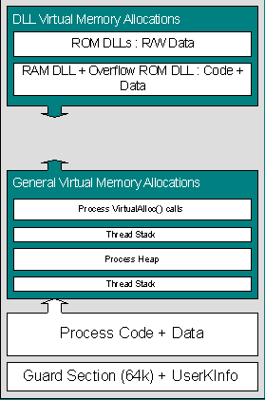
Lesson: Process Memory
32 MB Process Space
nk.exe
Slot 97
C400 0000
01FF FFFF
. . .
C200 0000
8000 0000
Resource DLLs
Slot 63
7E00 0000
. . .
4200 0000
Free Virtual Space
Slot 32
4000 0000
Slot 31
3E00 0000
Slot 30
3C00 0000
. . .
0C00 0000
gwes.exe
Slot 5
0A00 0000
device.exe
Slot 4
0800 0000
shell.exe
Slot 3
0001 0000
0600 0000
filesys.exe
Slot 2
0400 0000
0000 0000
XIP ROM DLLs
Slot 1
0200 0000
Current Process
Slot 0
0000 0000

Slide 41
Modules
Modules
  Standard Win32 Portable Executable file format
  Standard Win32 tools (symbols, digital signature, etc)
Dynamic Link Library (DLL)
  Loadable library with imports/exports to processes
  Same physical copy executed with different instance data
  Activate/Deactivate control by owner process
On demand paging
  Commits/Copies pages from storage into RAM for execution
  Execute-In-Place (XIP) of non-compressed ROM-based modules
  Decompresses ROM-based modules into RAM on-demand

Slide 42
System API Calling Mechanism
Coredll.dll
  Located at the top of every process slot
  Fields system API calls from user mode threads
  Implements some system API calls directly
  Causes an exception (trap) to pass on system API request
Kernel
  Catches system API request exception traps
  Dispatches to a system EXE to fulfill request
  User mode thread migrated to system EXE process space
  Access rights of user mode thread inherits current process rights

Slide 43
System API Calling Mechanism
App.exe
Nk.exe
system EXE
User mode thread
Return
Call
Kernel
Call
Function Call
Coredll.dll
Kernel
Trap
Win32 API Thunks
Win32 API Dispatch
Jump
Function Code

Slide 44
Heap
Usage
  Memory allocation with per-byte granularity
  Processor-independent (hides memory paging)
  Automatically allocates memory and commits pages on demand
  Non-movable (pages reclaimed when entire heap is free)
  Managed via singly-linked list of heap blocks using first-fit algorithm
  Works best with allocations of same-sized objects
Local Heap
  Reserves 192 KB virtual memory at process load time
  Commits physical pages upon allocation by process
Private Heap
  Reserves initial fixed size or expandable (disjointed) heap space
  Serialization for mutual exclusion of multiple threads
Shared Heaps
  Wwritable to owner process and read only to other processes

Slide 45
Stack
Usage
  Stores temporary data referenced within a function
  Stores state of processor registers during exception handling
  Default stack allocated for each thread at creation
  Committed on demand
Sizing
  CPU-dependent default stack size
  Default thread stack size override with /STACK linker switch
  All threads of a process have same stack size by default
Call Stack
  Stack checking detects buffer overruns with /GS linker switch
  GetThreadCallStack – retrieves call stack frames of a thread

